Slide 1
Comparison between f" and f´
f´ generally produce thicker edges in an image
f" have a stronger response to fine detail
f´ generally have a stronger response to a gray-level step
f" produces double response at step changes in gray level
f" responses given similar changes in gray-level values
point > step > line
For image enhancement, f" is generally better suited than f´
Major application of f´ is for edge extraction;
f´ used together with f" results in impressive enhancement effect
CUI, Lahore Campus -- CSC 331: Digital Image Processing -- © Dr. Usama Ijaz Bajwa

Slide 2
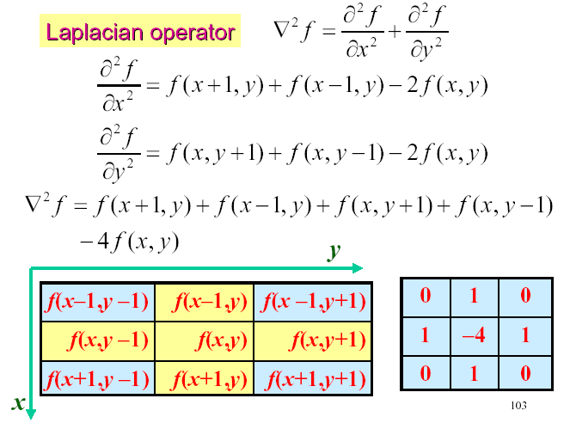
Laplacian for image enhancement
CUI, Lahore Campus -- CSC 331: Digital Image Processing -- © Dr. Usama Ijaz Bajwa

Slide 3
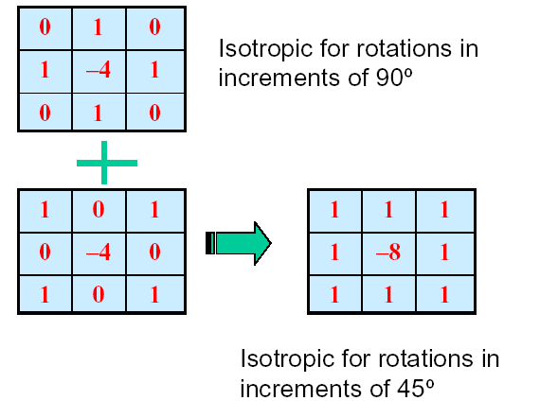
Laplacian for image enhancement
CUI, Lahore Campus -- CSC 331: Digital Image Processing -- © Dr. Usama Ijaz Bajwa

Slide 4

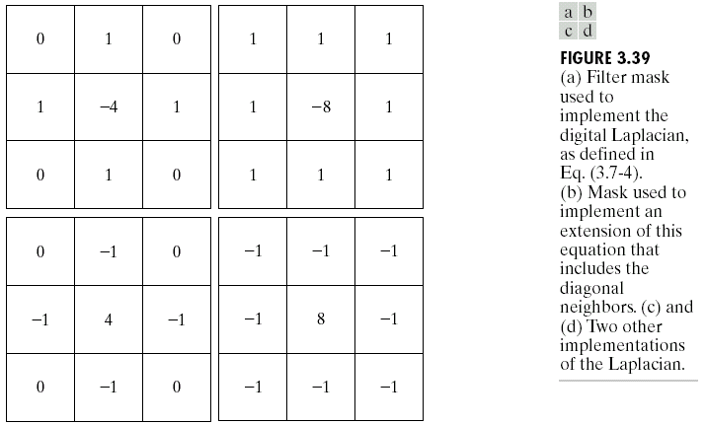
Laplacian for image enhancement
CUI, Lahore Campus -- CSC 331: Digital Image Processing -- © Dr. Usama Ijaz Bajwa

Slide 5
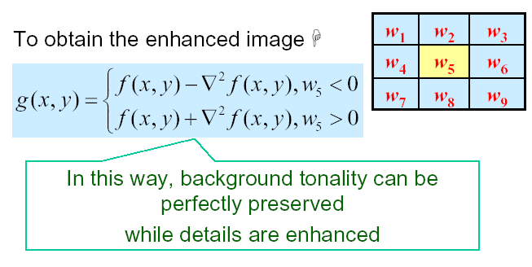
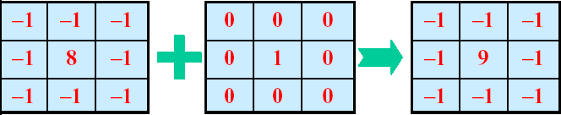
Laplacian for image enhancement
CUI, Lahore Campus -- CSC 331: Digital Image Processing -- © Dr. Usama Ijaz Bajwa

Slide 6
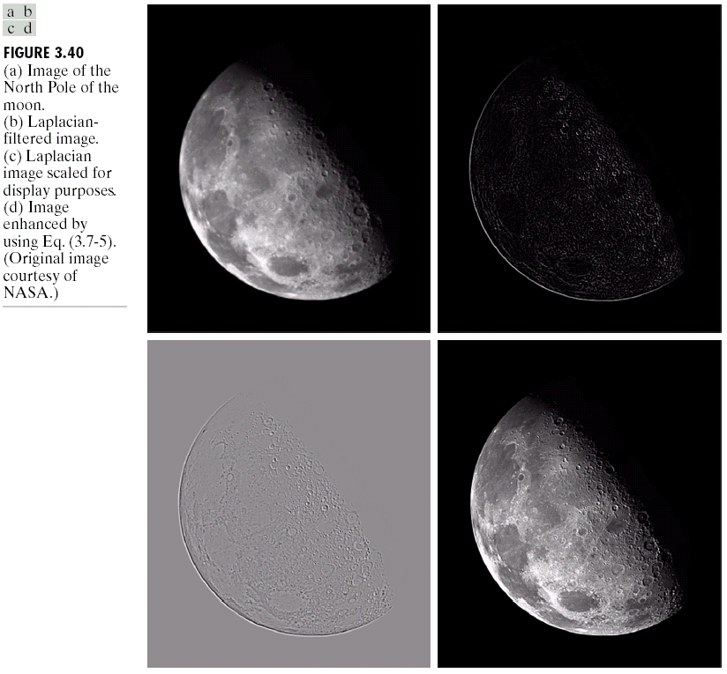
Laplacian for image enhancement (example)
CUI, Lahore Campus -- CSC 331: Digital Image Processing -- © Dr. Usama Ijaz Bajwa

Slide 7
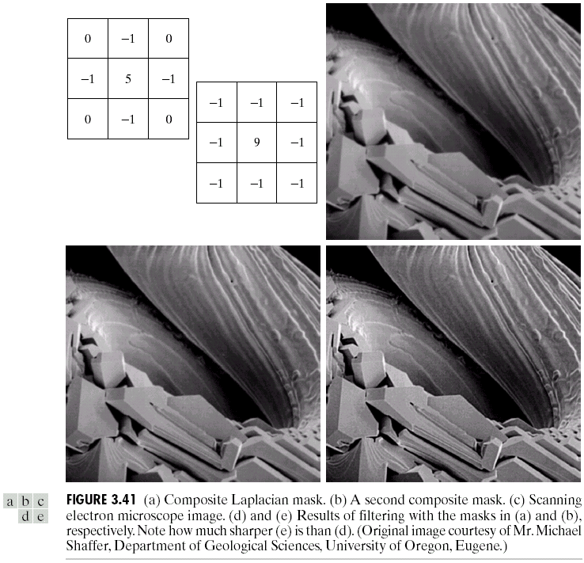
Laplacian for image enhancement (example)
CUI, Lahore Campus -- CSC 331: Digital Image Processing -- © Dr. Usama Ijaz Bajwa

Slide 8
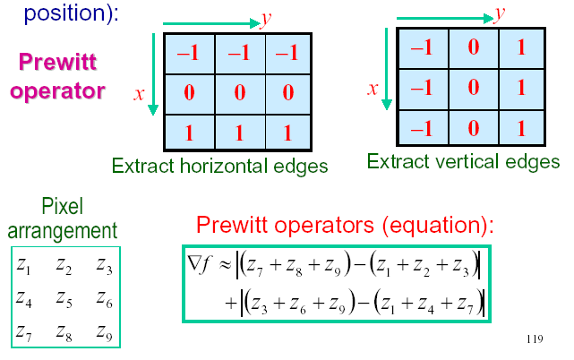
Gradient Operators
Normally the smallest mask used is of size 3 x 3
Based on the concept of approximating the gradient several spatial masks have been proposed:
CUI, Lahore Campus -- CSC 331: Digital Image Processing -- © Dr. Usama Ijaz Bajwa

Slide 9
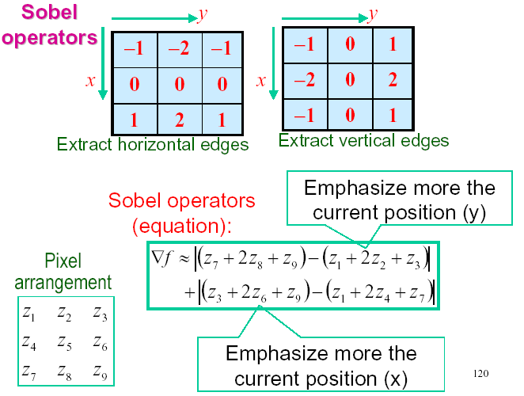
Gradient Operators
CUI, Lahore Campus -- CSC 331: Digital Image Processing -- © Dr. Usama Ijaz Bajwa

Slide 10
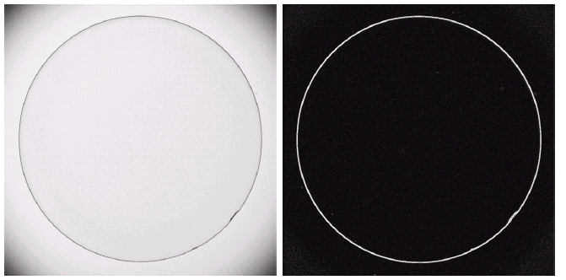
Gradient Operators
Optical image of contact lens (note defects at 4 and 5 o’ clock
Sobel gradient
CUI, Lahore Campus -- CSC 331: Digital Image Processing -- © Dr. Usama Ijaz Bajwa

Slide 11
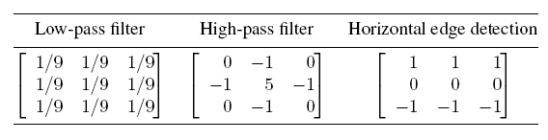
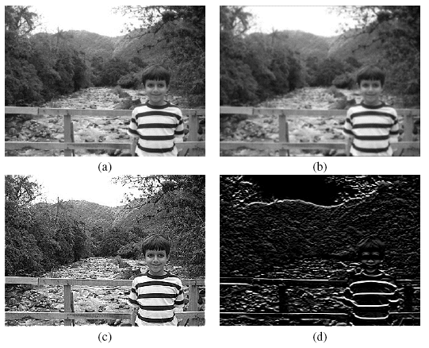
Summary
  Depending on the choice of mask coefficients, entirely different results can be obtained.
CUI, Lahore Campus -- CSC 331: Digital Image Processing -- © Dr. Usama Ijaz Bajwa

Slide 12
Combining spatial enhancement methods
When faced with a practical image processing problem, a question arises:
Which techniques should I use and in which sequence ?
There is no universal answer to this question.
  Most image processing solutions are problem-specific and involve the application of several algorithms -- in a meaningful sequence -- to achieve the desired goal.
  The choice of algorithms and fine-tuning of their parameters is a trial-and-error process.
  Using the knowledge acquired so far you should be able to implement, configure, fine-tune, and combine image processing algorithms for a wide variety of real-world problems.
CUI, Lahore Campus -- CSC 331: Digital Image Processing -- © Dr. Usama Ijaz Bajwa

Slide 13
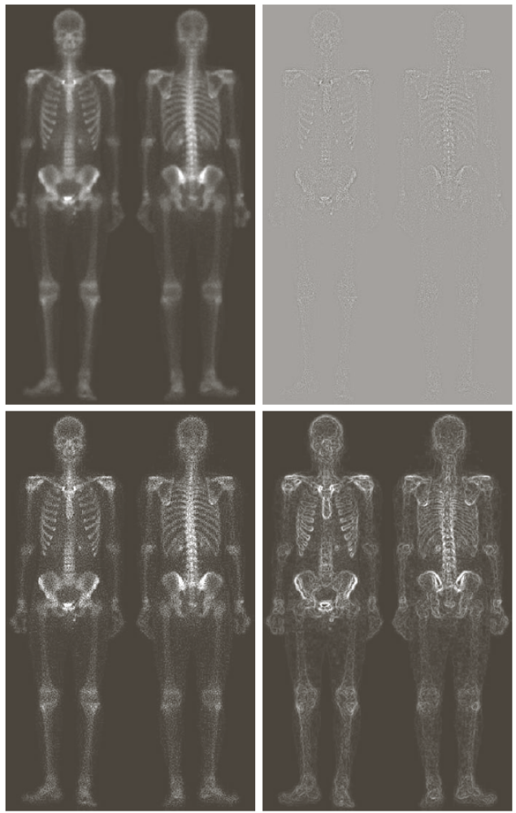
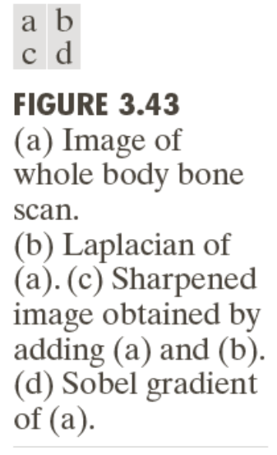
Combining spatial enhancement methods
CUI, Lahore Campus -- CSC 331: Digital Image Processing -- © Dr. Usama Ijaz Bajwa

Slide 14
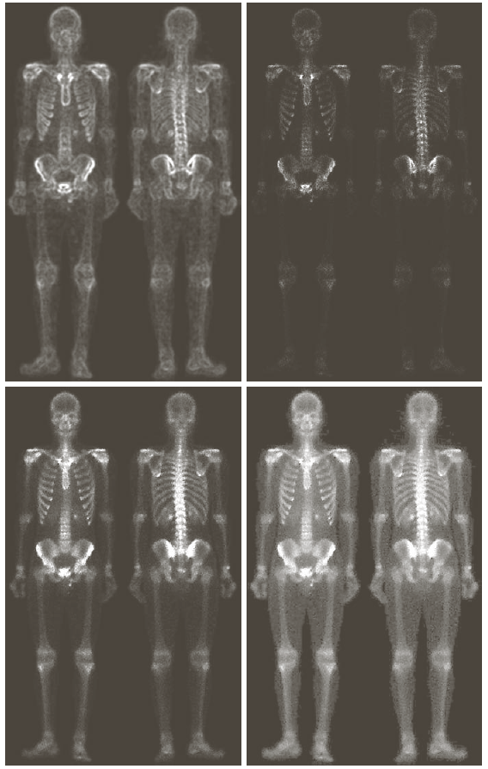
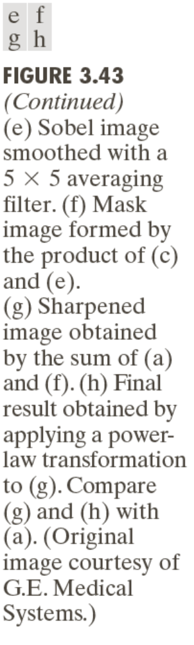
Combining spatial enhancement methods
CUI, Lahore Campus -- CSC 331: Digital Image Processing -- © Dr. Usama Ijaz Bajwa

Slide 15
Hands On
Practical Image and Video Processing Using MATLAB – By Oge Marques
Tutorial 10.1: Convolution and correlation (page 223)
Tutorial 10.2: Smoothing filters in the spatial domain (page 225)
Tutorial 10.3: Sharpening filters in the spatial domain (page 228)
CUI, Lahore Campus -- CSC 331: Digital Image Processing -- © Dr. Usama Ijaz Bajwa

Slide 16
Geometric Spatial Transformations (Rubber Sheet)
Modify the geometry of an image by repositioning pixels in a constrained way.
Modify the spatial relationships between groups of pixels representing features or objects of interest within the image.
Are used for different purposes:
  Correction of geometric distortions introduced during the image acquisition process;
  Special effects (e.g., twirling, bulging, or squeezing);
  As part of image registration
CUI, Lahore Campus -- CSC 331: Digital Image Processing -- © Dr. Usama Ijaz Bajwa

Slide 17
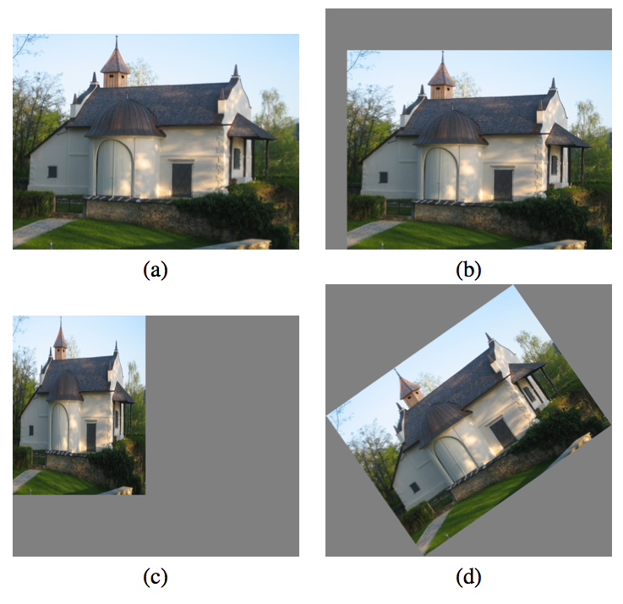
Geometric Spatial Transformations
CUI, Lahore Campus -- CSC 331: Digital Image Processing -- © Dr. Usama Ijaz Bajwa

Slide 18
Geometric Spatial Transformations
Two basic components:
  mapping function, specified using a set of spatial transformation equations (and a procedure to solve them)
  and
  interpolation methods, used to compute the new value of each pixel in the spatially transformed image.
CUI, Lahore Campus -- CSC 331: Digital Image Processing -- © Dr. Usama Ijaz Bajwa

Slide 19
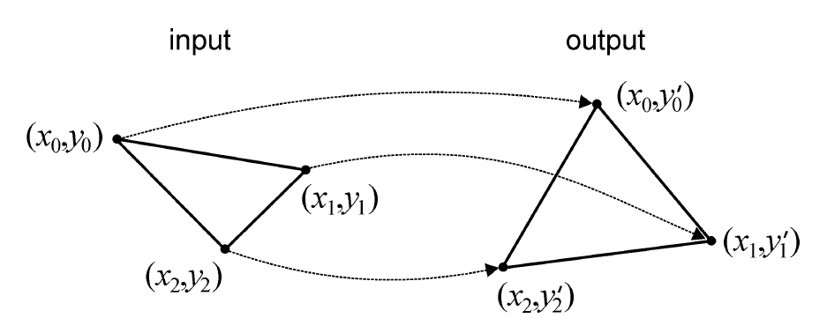


Geometric Spatial Transformations
CUI, Lahore Campus -- CSC 331: Digital Image Processing -- © Dr. Usama Ijaz Bajwa

Slide 20

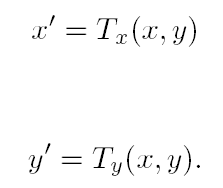
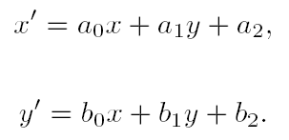
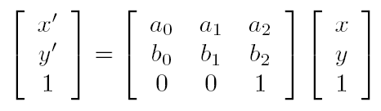
Geometric Spatial Transformations
CUI, Lahore Campus -- CSC 331: Digital Image Processing -- © Dr. Usama Ijaz Bajwa

Slide 21
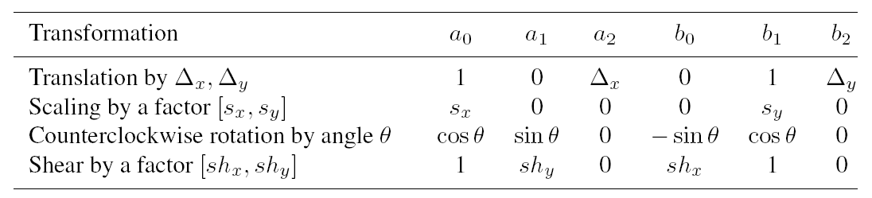
Geometric Spatial Transformations
CUI, Lahore Campus -- CSC 331: Digital Image Processing -- © Dr. Usama Ijaz Bajwa

Slide 22
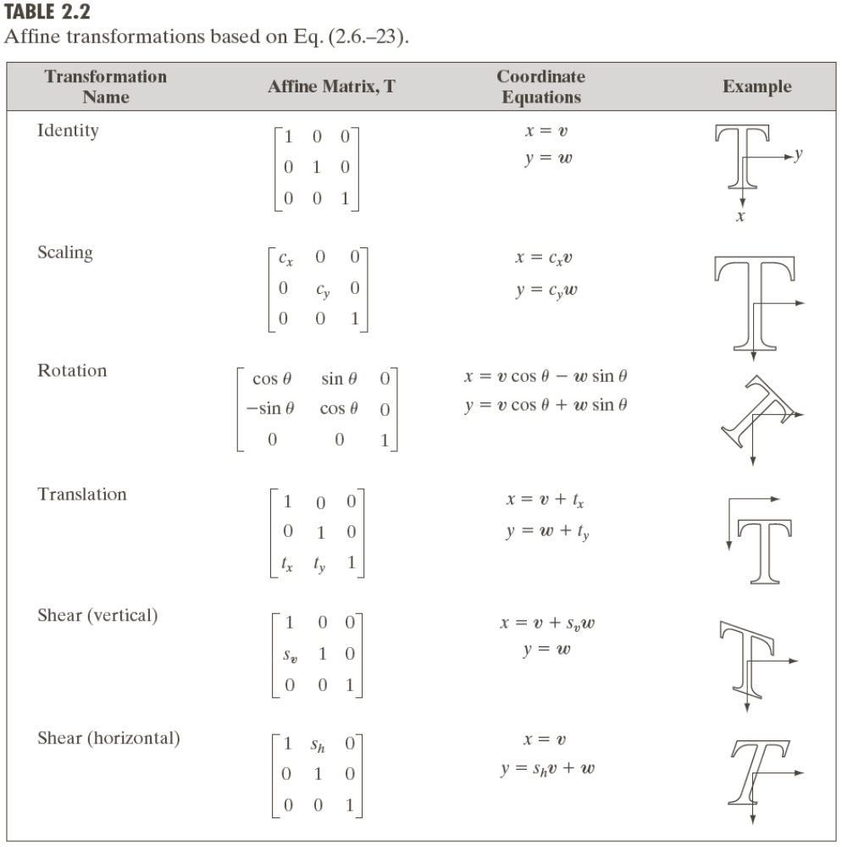
Geometric Spatial Transformations (Rubber Sheet)
CUI, Lahore Campus -- CSC 331: Digital Image Processing -- © Dr. Usama Ijaz Bajwa

Slide 23
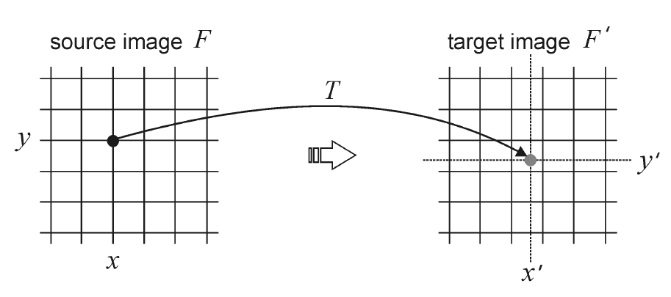
Geometric Spatial Transformations
Forward Mapping
CUI, Lahore Campus -- CSC 331: Digital Image Processing -- © Dr. Usama Ijaz Bajwa

Slide 24
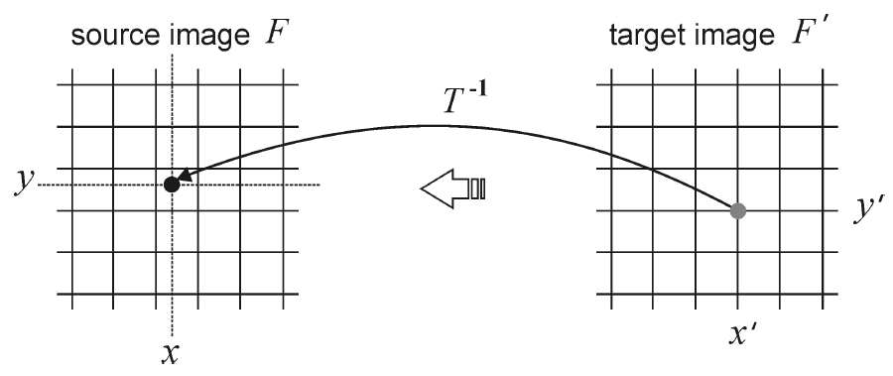
Geometric Spatial Transformations
Reverse Mapping
CUI, Lahore Campus -- CSC 331: Digital Image Processing -- © Dr. Usama Ijaz Bajwa

Slide 25
Geometric Spatial Transformations (Rubber Sheet)
Forward Mapping
Scan through the source image pixel by pixel, and copy them to the appropriate place (as per transformation) in the destination image.
Some pixels in destination image don’t get any value (Gaps)
Some pixels in destination image get multiple values (Overlaps)
Reverse Mapping
Go through the destination image pixel by pixel, and sample the correct pixel from the source image by inverse of transformation.
CUI, Lahore Campus -- CSC 331: Digital Image Processing -- © Dr. Usama Ijaz Bajwa

Slide 26
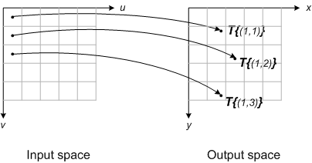
Forward Mapping
Consider each input image pixel in turn. For each input image pixel:
Determine its location in input space, (u_{k},v_{k}).
Map that location to output space using (x_{k},y_{k}) = T{(u_{k},v_{k})}.
Figure out which output pixel contains the location (x_{k},y_{k}).
Copy the input pixel value to that output pixel.
CUI, Lahore Campus -- CSC 331: Digital Image Processing -- © Dr. Usama Ijaz Bajwa

Slide 27
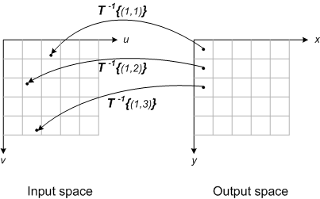
Reverse Mapping
Locate output image pixel grid somewhere in output space. Then for each output pixel on the grid:
Apply the inverse spatial transformation to determine the corresponding location in input space: (u_{k},v_{k}) = T⁻¹{(x_{k},y_{k})}.
Using the input image pixels nearest to (u_{k},v_{k}), interpolate to get an approximate value for the input image at (u_{k},v_{k}).
Use that value for the k-th output pixel.
CUI, Lahore Campus -- CSC 331: Digital Image Processing -- © Dr. Usama Ijaz Bajwa

Slide 28
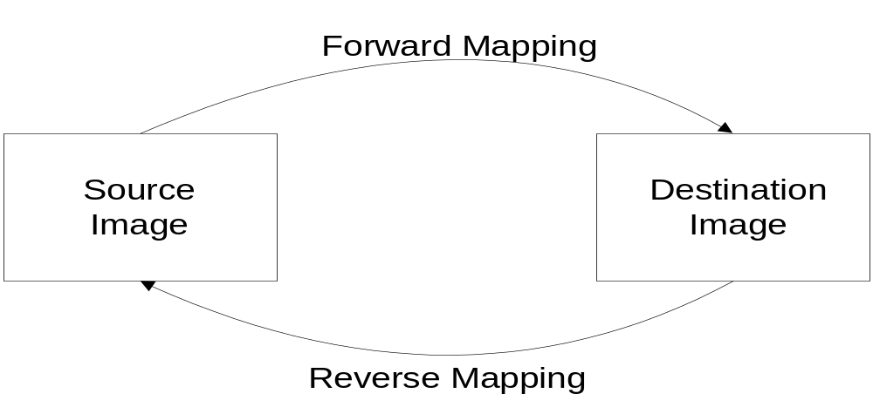
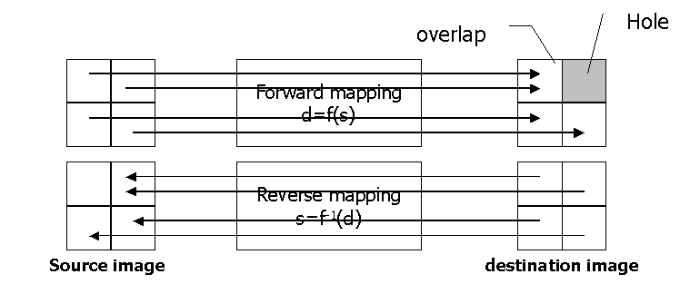
Mapping Schemes
CUI, Lahore Campus -- CSC 331: Digital Image Processing -- © Dr. Usama Ijaz Bajwa

Slide 29
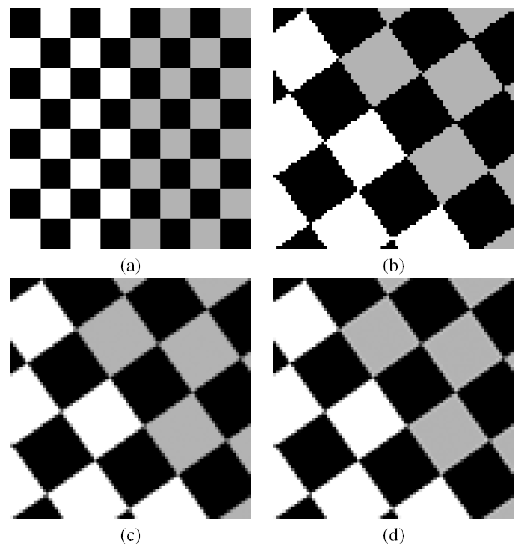
Interpolation Methods
Zero-order (nearest neighbor) interpolation
First-order (bilinear) interpolation
Higher-order interpolations (e.g., bicubic)
CUI, Lahore Campus -- CSC 331: Digital Image Processing -- © Dr. Usama Ijaz Bajwa

Slide 30
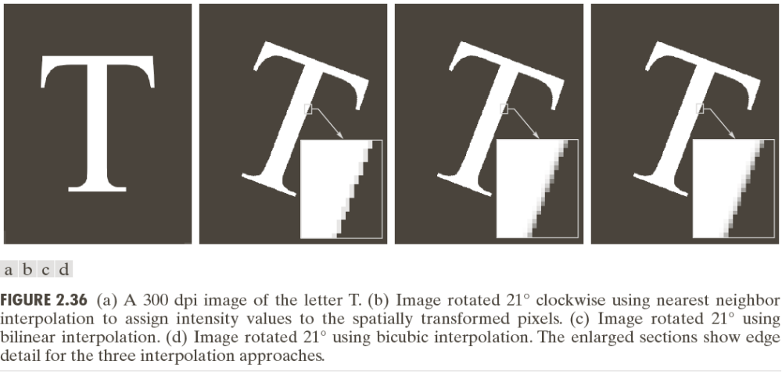
Geometric Spatial Transformations (Rubber Sheet)
CUI, Lahore Campus -- CSC 331: Digital Image Processing -- © Dr. Usama Ijaz Bajwa

Slide 31
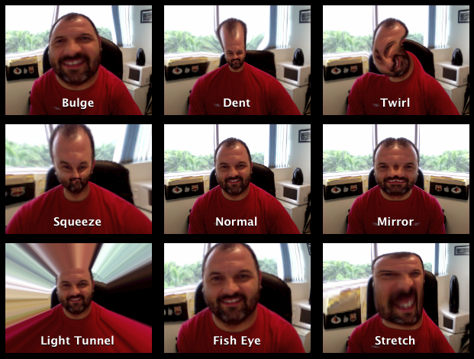
Non Linear Transformations
CUI, Lahore Campus -- CSC 331: Digital Image Processing -- © Dr. Usama Ijaz Bajwa

